Slide 1
Up and Running with Fedora CoreOS

Slide 2
Housekeeping
If you wish to use AWS for your deployment I have two options for you:
- Send your email to davdunc+devconf2021@amazon.com
- 428 Kč ($20 US) Credit will be generated and sent to cover the workshop costs.
- Generate credentials for a temporary account live for today only and provide to you
- Send your email to davdunc+cztemp@amazon.com and I’ll respond with credentials for the short term.
Faster and easier to setup an account, but we understand that not everyone can do that.

Slide 3
Intended Audience
The curious developer
Anyone who wants to build a workshop to extend these basic steps.
Anyone who wants to build with Fedora CoreOS, but doesn’t know where to start.

Slide 4
Why ME?
Why am I here talking to you about this effort?
Notes:
** Why Am I up in front of the Class
I wanted to know how to build with Red Hat CoreOS, but i wanted to be able to contribute to .
I have access to the resources.
I want to help more people understand the steps and the programs.
I want help build a gameday event for Fedora CoreOS

Slide 5
Step 1: Discovery of images and preparations
The Update Streams
Next
Testing
Stable
The URI: https://builds.coreos.fedoraproject.org/streams/stable.json
represents the available stable configuration
Exercise 1: Can you review the available update stream URI and infer the corresponding details for each of the other two update streams?
Exercise 2: You suddenly work on Amazon EC2. How would I use this detail to build an AWS API call and locate the exact Amazon machine images I need to deploy to a cluster in eu-central-1?
Hint: https://access.redhat.com/solutions/15356
Notes:
RELEASE=$(curl -s --output - https://builds.coreos.fedoraproject.org/streams/next.json | jq -Mr '.architectures.x86_64.artifacts.aws.release | @text' )
davdunc@localhost:~$ aws ec2 describe-images --owners 125523088429 --filters "Name=name,Values=*$(echo ${RELEASE} | tr -d '"')*" --region us-east-1
Build a response using curl or python simplestreams
curl -s --output - https://builds.coreos.fedoraproject.org/streams/stable.json | jq '.architectures.x86_64.artifacts.aws.release'

Slide 6
Exercise 2: Review time
davdunc@localhost:~$ curl -s --output - \
> https://builds.coreos.fedoraproject.org/streams/stable.json | jq \
> '.architectures.x86_64.images.aws.regions' | head -30
{
"af-south-1": {
"release": "33.20210201.3.0",
"image": "ami-0e33217ebb547dd4c"
},
"ap-east-1": {
"release": "33.20210201.3.0",
"image": "ami-03d0d3e3389fec61f"
},

Slide 7
Applying what you learned:
What are artifacts?
What if I want to build on qemu+kvm where is that Image?
Something to think about later… How am I going to move from testing to stable?
Notes:
davdunc@LOCALHOST:~$ curl -s --output - https://builds.coreos.fedoraproject.org/streams/stable.json | jq -r '.architectures.x86_64.images.aws.regions."us-east-1".image'

Slide 8
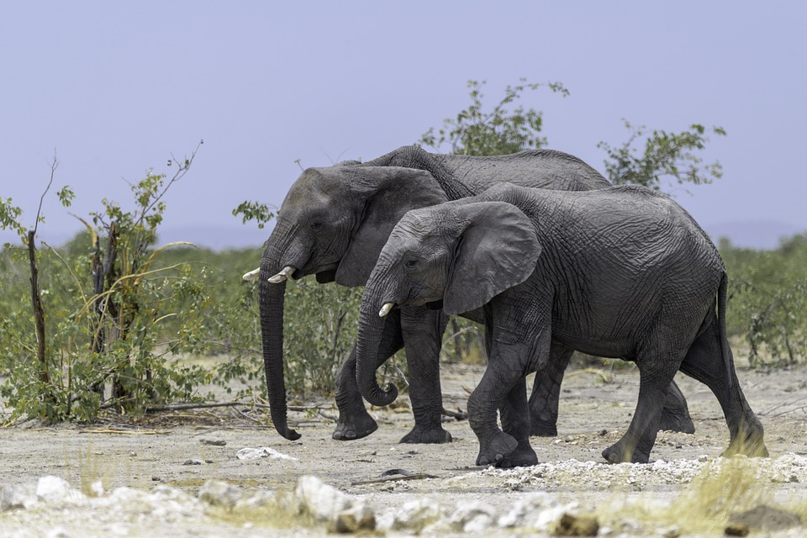
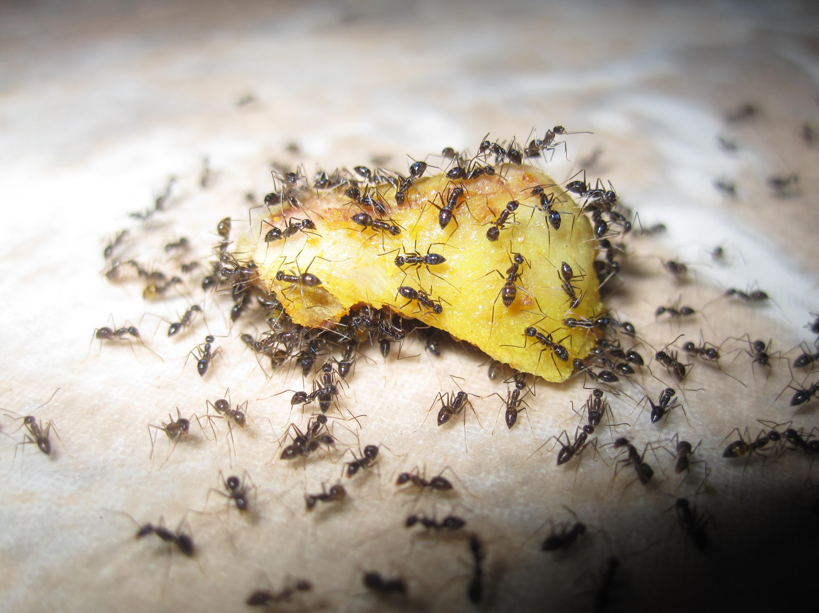
First Deployment
From Elephants to Ants
Fedora CoreOS from One Instance to many.

Slide 9
I found my image now what?
Exercise 1: Execute an install on your environment of choice.
You’ll need
An ssh key
An ignition file
A default user
1a: Install to AWS
"eu-central-1": {
"release": "33.20210201.3.0",
"image": "ami-0c9587e7eb210ab95" }
Use a t3.micro for free tier elegibility
1b: Install to local KVM
'opt/com.coreos/config'

Slide 10
What’s an ignition file?
Fedora CoreOS is an image.
Installation is the same.
Starts with a YAML file called:
Fedora CoreOS Configuration
You’ll need a “Transpiler”.
@host> podman pull quay.io/coreos/fcct:release
Bonus discussion points:
What is user data?
What is a link local address?
Exercise 1:
Build a Fedora CoreOS Configuration file with an SSH key you build on your own.
Convert that to JSON for use as an ignition file.
Notes:
The ignition file makes the image work for you

Slide 11
What’s it look like?
FCC
variant: fcos
version: 1.2.0
passwd:
users:
- name: coreos
ssh_authorized_keys:
- ssh-rsa ssh-rsa AAAAB3NzaC1y . . .
Ignition
{
"ignition": {
"version": "3.2.0"
},
"passwd": {
"users": [
{
"name": "coreos",
"sshAuthorizedKeys": [
"ssh-rsa AAAAB3NzaC1yc2EAAAADAQ . . .
Notes:
Look at that! The structure

Slide 12
Let’s change it up
Exercise1:
Configure a second user or configure a different user in a build process.
Exercise2:
On your own, add the fcct to the installation of the instance using ignition
Building the configuration.
Do we really need the default user on the system?
Why or Why not?
Use the fcct with redirects automatically and save your file in a second storage device.

Slide 13
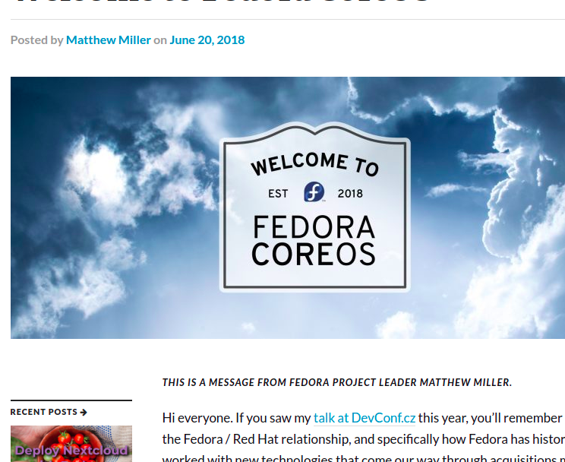
Automating the process in your environments
Through Red Hat Ansible
Using the community.aws.ec2_instance
Or using the community.aws.ec2_launch_template
Notes:
Fedora CoreOS was announced shortly after the purchase of CoreOS by Fedora’s primary sponsor, Red Hat. The Fedora CoreOS development was complementary with the foundational work for Project Atomic and a decision to combine the best of these projects was made. This didn’t forsake

Slide 14
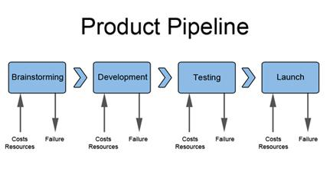
Building a basic pipeline

Slide 15
Questions

